Slide 1
Flight Price Prediction
Web Scraping / regression project presentation
Saurav kumar

Slide 2
Problem Statement
Anyone who has booked a flight ticket knows how unexpectedly the prices vary. The cheapest available ticket on a given flight gets more and less expensive over time. This usually happens as an attempt to maximize revenue based on –
1. Time of purchase patterns (making sure last-minute purchases are expensive)
2. Keeping the flight as full as they want it (raising prices on a flight which is filling up in order to reduce sales and hold back inventory for those expensive last-minute expensive purchases)
So, you have to work on a project where you collect data of flight fares with other features and work to make a model to predict fares of flights.

Slide 3
Problem Story :-
In this problem we have to scrap the data from any flight booking website . And we have to predict the flight ticket price .and if we book our ticket in last minute our ticket is expensive and If the more person try to book the ticket in same date then usually ticket price bumps high.
So , In this question we are using the Yatra.com for scraping the data . And predict the price .. Using some information.
In next slide I am highlighting tie scraped data for model building using yellow highlighter.

Slide 4
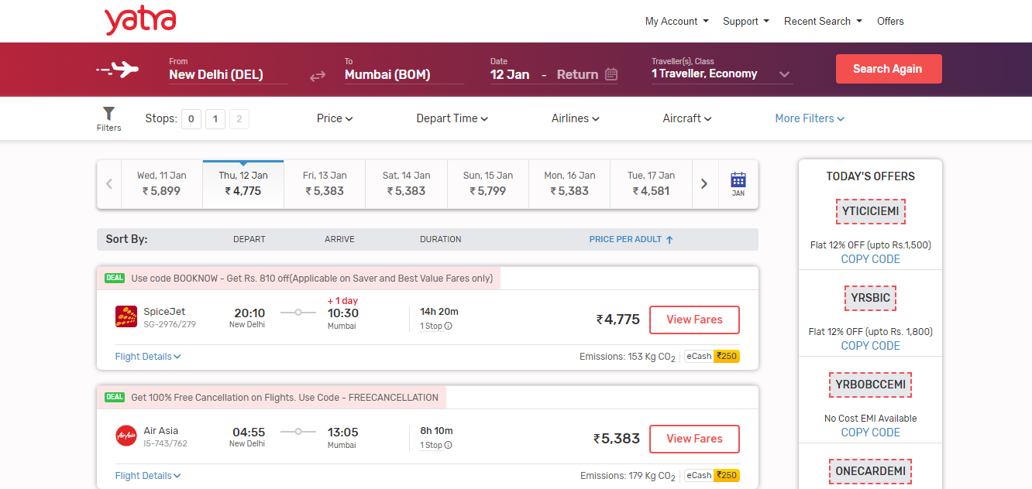






Slide 5
Scraped Data :
Source and Destination
Date of Journey
Price
Duration
Total Stops
Airline

Slide 6
Goal
Forecast Flight Prices
Select Optimum time for travel
Selecting the cheapest flight for desired destination

Slide 7
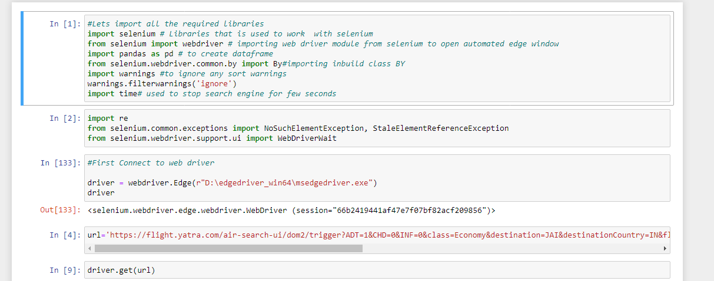
Scraping
Here I am using Selenium for scraping the data .

Slide 8
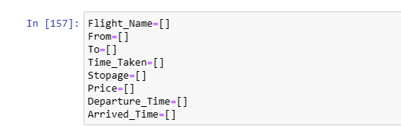
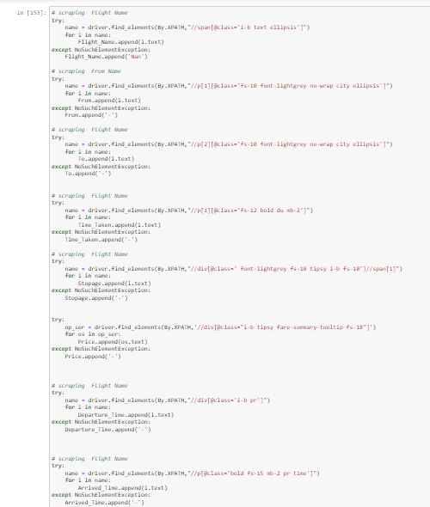
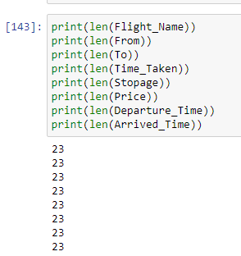
Here we scrap
Rows – 3731
Column - 11

Slide 9
About Dataset
Here , We have 3731 Rows and 11Columns
We don’t have any null values
All the data type of the columns is object we have convert them in float and date time.

Slide 10
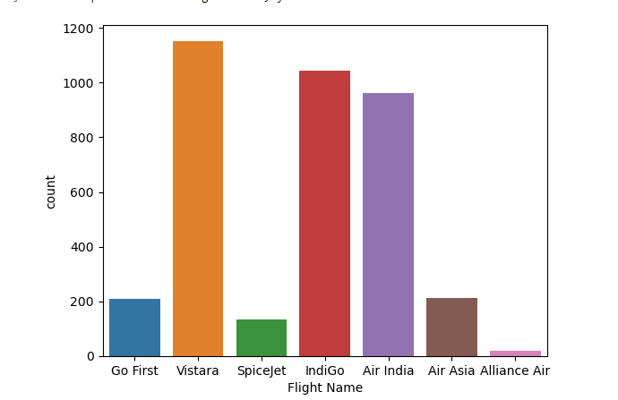
EDA - Exploratory Data Analysis
Lets check the Which are line is more Fly.
Here we can see that Vistara ,
Indigo are fly most and alliance
Air is very less in count.

Slide 11
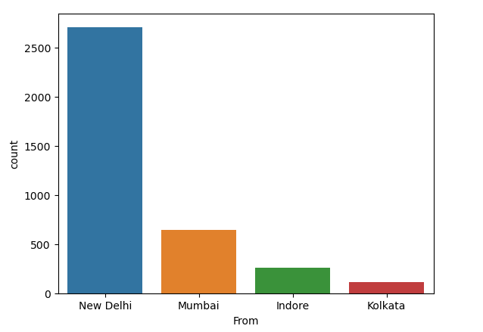
Lets plot which city we have to use for Traveling .
Here , We can see that we scrap max
Of the data from Delhi and Mumbai and
Least for Kolkata.

Slide 12
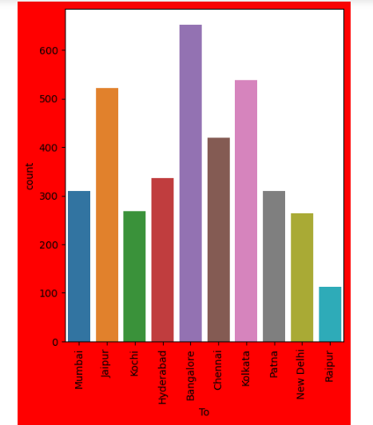
Lets plot Which City We want to travel
Here , We can see all the cities belongs to india .and highest
Flights comes in Banglore then Kolkata in least in Raipur.

Slide 13
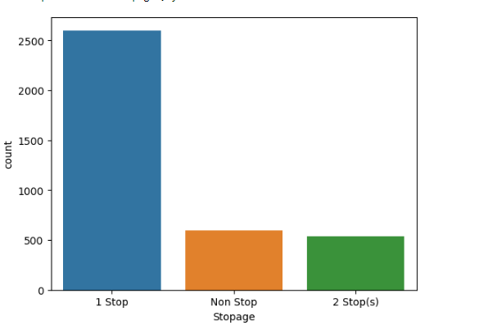
Lets plot the Stopage
Here , We can see that most of
The flights are 1 Stop , and Non
Stop and 2Stops flight are
Equal in Counts.

Slide 14
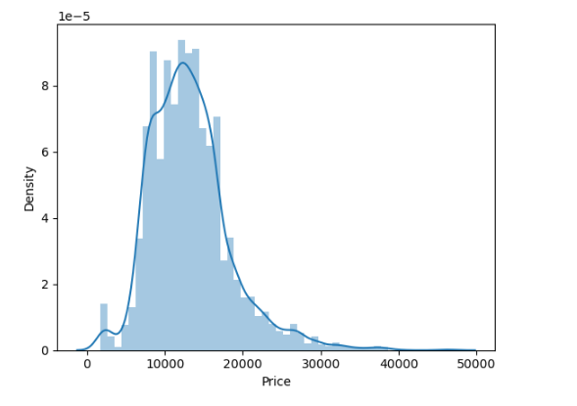
Lets plot Distribution Plot of Target Column
Look like Normal Distribution . But Right
Skewed..

Slide 15
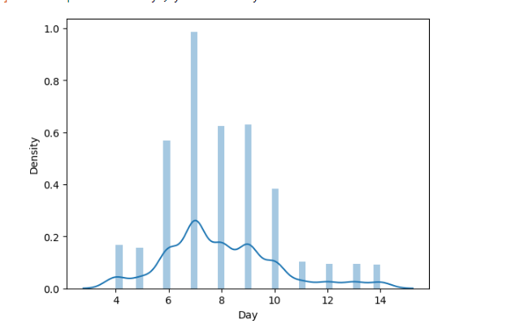
Lets plot Date Column Distribution plot
So , Here we can see that
It’s a normal distribution

Slide 16
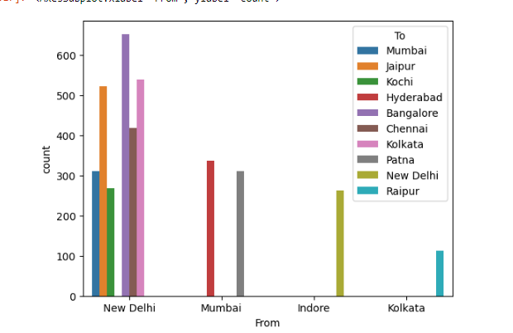
Lets plot From and To to check which airport can fly maximum aeroplan
Here wer can see that
Maximum plane fly from
New delhi.

Slide 17
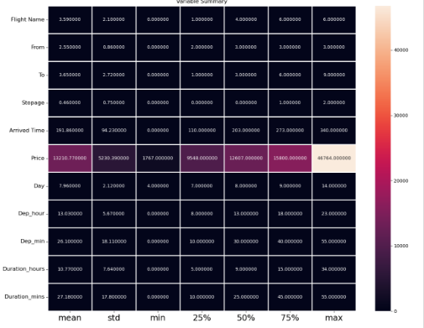
Description of the Dataset

Slide 18
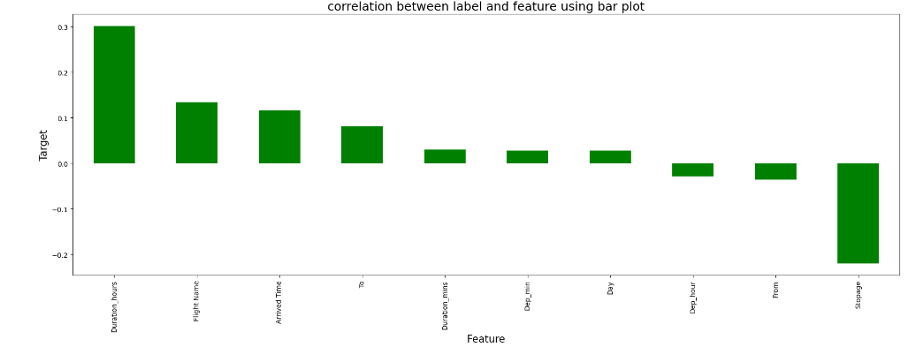
Correlation with Target Variable
Here we can see that Duration Hours have good relation with Price
Stopage have negative relation with Price Columns
Duration Minute , Dep_min ,Day , Dep_Hour and From have Less Relation

Slide 19
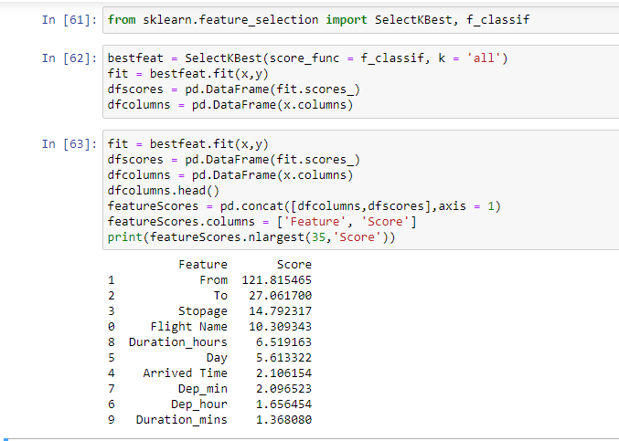
Feature Selection
Using Select K best

Slide 20
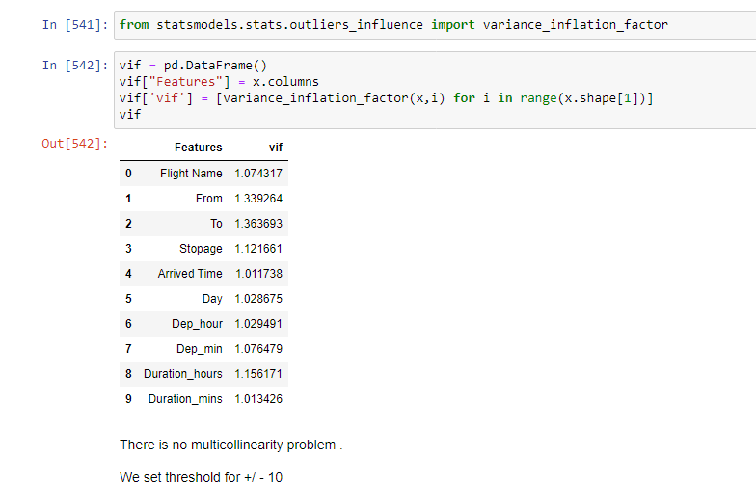
Checking MultiCollinearity
Here , We can set threshold for
+-/10. and we can find all feature
Are comes in our range . It means
There is not any multicollinearity
Problem.

Slide 21



Lets Build Model
Random Forest ->
Gradient Boost ->
XGB ->
So , Here I am using almost algorithm but I am using XGB Because its giving me best accuracy
And good Cross Validation Score.
Cross Validation Score ->

Slide 22
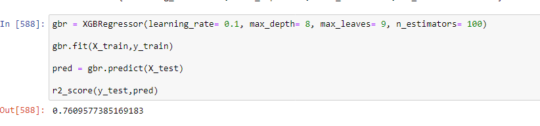
Hyperparameter Tuning
Using GridSearchCV
Here we get 76 % accuracy .

Slide 23
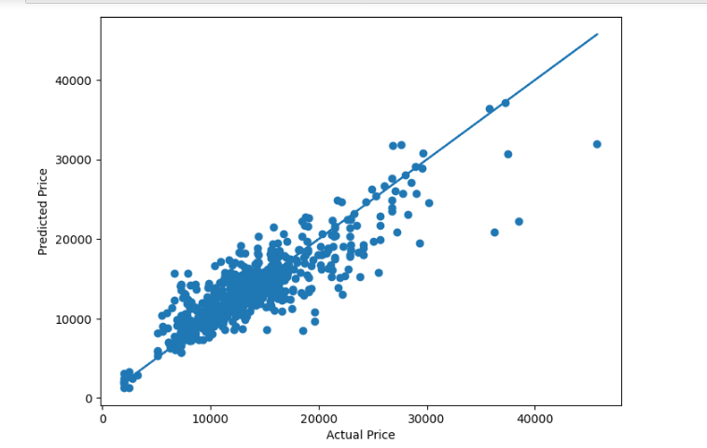
Best Fit Line
Here , We can see that our most
Of the data comes in the near the
Best fit line.

Slide 24
Thankyou

